Slide 1

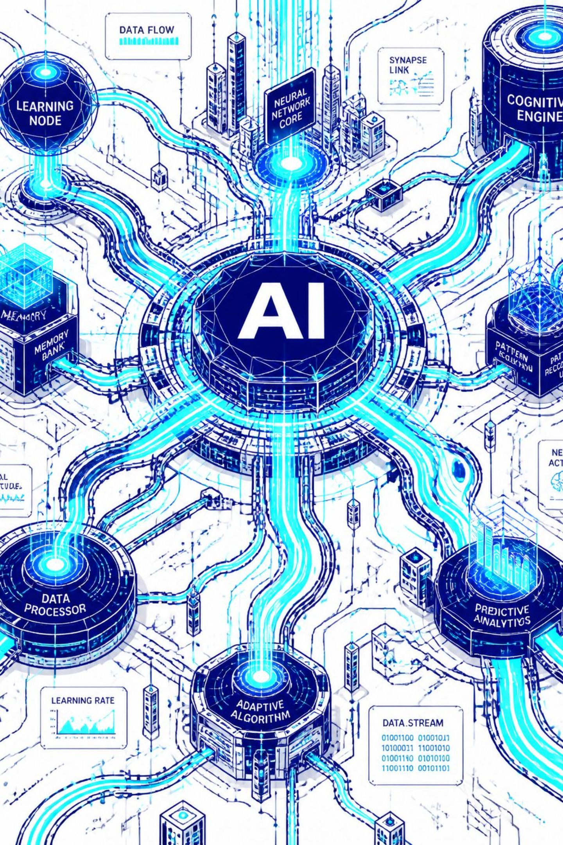
AI-Based Automatic FAQ Generation from Technical Documents
An Intelligent NLP-Based System for Automatically Generating Frequently Asked Questions from Technical Documents
Group 3 :-
Motukuri Vaishnavi - 2420030665
V. Varshita 2420030230
Bhashetty Shaanvi 2420039806

Slide 2
Objectives
-To develop an automatic FAQ generation system using the T5 Transformer.
- To process documents in PDF, DOCX, and TXT formats.
–To extract key context and meaning to improve information accessibility.
- To evaluate system performance using Accuracy.
- To build a user-friendly web interface for document upload and FAQ display.
- To reduce manual time and effort in reading documents and creating FAQs.

Slide 3
Problem statement
- Technical documents are lengthy and dense, making it hard to find specific information
Users spend excessive time searching for answers
FAQs are often prepared manually, making the process time-consuming and resource-intensive.
Existing approaches have limited capability to automatically generate contextual FAQs from technical documents

Slide 4
LITERATURE SURVEY
No. | Research Paper | Model / Technique | Outcome | Limitation Relevant to Project | Dataset(s)
1 | Learning to Ask: Neural Question Generation for Reading Comprehension | Attention-based Seq2Seq neural question generation | Showed that an end-to-end neural model can generate more natural and fluent questions than earlier rule-based approaches. | Focuses on reading-comprehension questions, not multi-format technical documents, FAQ organization, or searchable knowledge bases. | SQuAD
2 | Identifying Where to Focus in Reading Comprehension for Neural Question Generation | Hierarchical neural sentence-level sequence tagging | Identified question-worthy sentences and improved paragraph-level neural question generation on SQuAD. | Designed for reading-comprehension passages, not technical-document FAQ priorities. | SQuAD
3 | Paragraph-level Neural Question Generation with Maxout Pointer and Gated Self-attention Networks | Maxout Pointer + Gated Self-Attention | Improved question generation for longer paragraph inputs and reported a BLEU-4 improvement to 16.3 in the paper's setting. | Struggles with long documents and is mainly tested on reading-comprehension tasks, not diverse technical documents. | SQuAD
4 | Answer-focused and Position-aware Neural Question Generation | Answer-focused and position-aware Seq2Seq model | Used answer information and relative position to improve question-word selection and reduce copying of irrelevant context words. | Requires explicit answer information and focuses on benchmarks, unlike automated technical-document processing | SQuAD

Slide 5
Research Gap Identification
Existing System
– Keyword-Based Search: Information is retrieved mainly by matching the keywords entered by the user with the words available in the document.
Limited Context Understanding: The system focuses on individual words or phrases and has difficulty understanding the overall meaning and context of the document.
Manual FAQ Creation: Users have to read the document, identify important information, and manually create suitable questions and answers.
Time-Consuming Process: Preparing FAQs from large documents requires more human involvement and takes considerable time and effort.
- Static Information Retrieval: The system provides predefined or search-based results instead of dynamically generating relevant questions and answers.

Slide 6
Proposed AI System
- Semantic NLP Understanding: The proposed system uses NLP techniques to understand the context and meaning of the document instead of depending only on keyword matching.
- Automatic FAQ Generation: The system automatically identifies important content and generates relevant questions and answers from the uploaded document.
- T5 Transformer Model: The T5 Transformer is used to process the extracted content and generate meaningful and context-aware question–answer pairs.
- Dynamic FAQ Generation: FAQs are generated dynamically according to the content of each document, providing more relevant information to the user.
- Reduced Human Effort: The system minimizes manual reading and FAQ preparation, allowing users to obtain useful FAQs quickly after uploading their documents.

Slide 7
Proposed Solution & System Workflow
Document Upload
Sentence Segmentation
T5 Transformer Model
Searchable FAQ Database
Text Extraction & Cleaning
Text Chunking
FAQ Generation
Web Application
The system extracts and preprocesses document text, divides it into manageable chunks, generates question-answer pairs using the T5 Transformer model, and stores them in a searchable FAQ database.

Slide 8
Datasets
Dataset | Purpose
Python Documentation | Used to generate FAQs from Python programming documentation.
Java Documentation | Used to generate FAQs from Java documentation.
TensorFlow Documentation | Used to generate FAQs from Machine Learning documentation.
User-uploaded Technical Documents (PDF/DOCX/TXT) | Input documents uploaded by users for automatic FAQ generation.

Slide 9




Innovation, Creativity & Novelty
Innovation
Creativity
AI-powered FAQ generation using the T5 Transformer — a state-of-the-art text-to-text model trained to produce coherent Q&A pairs from raw text.
Automatically transforms lengthy, complex technical documents into concise, readable FAQs — saving hours of manual documentation effort.
Novelty
Unlike search tools, the system generates new question-answer pairs rather than extracting existing text. It is a generative approach rather than a retriever-based approach. It also supports multiple technical document formats (PDF, DOCX, and TXT).

Slide 10


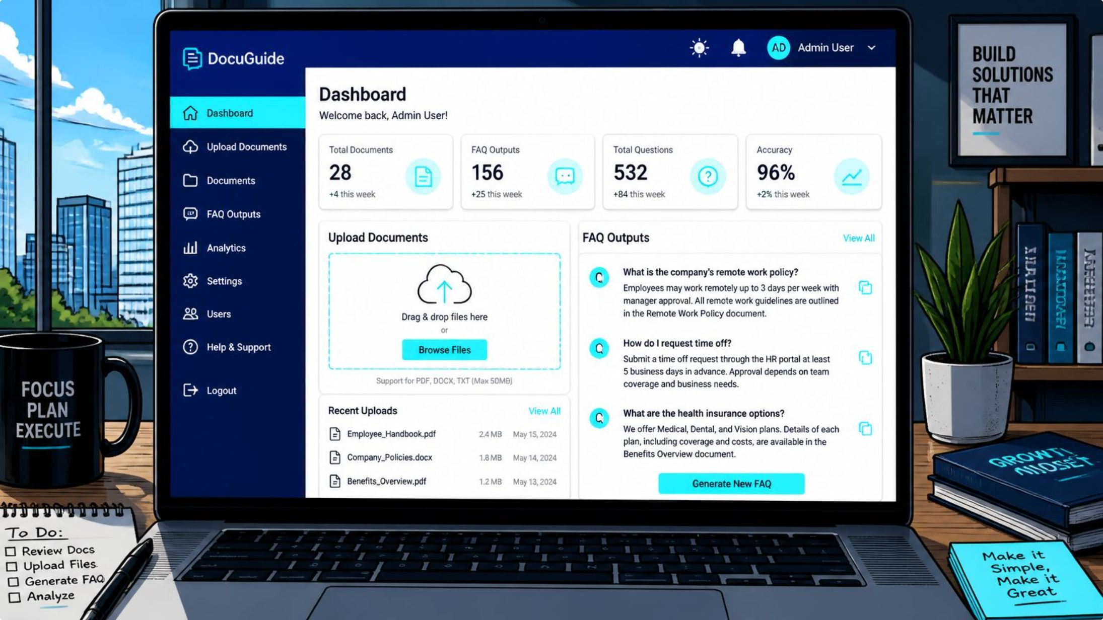




Feasibility Analysis
Technical Feasibility
Developed using Python, NLP libraries, and the T5 Transformer model. The proposed technologies are open-source, reliable, and well documented.
Economic Feasibility
Entirely open-source stack — zero licensing costs. Deployable on low-cost cloud or local servers.
Operational Feasibility
Simple web interface — upload a document, receive FAQs. No technical expertise required from end users.
Schedule Feasibility
Modular design allows parallel development. Completable within one academic semester with a 4–5-person team.

Slide 11
Project Plan & Timeline
Weeks 1–2
1
Research — Literature survey, requirement analysis, tool selection
2
Weeks 3–4
System Design — Architecture, UI/UX wireframes, database schema
Weeks 5–6
3
Document Processing — Text extraction, cleaning, chunking pipeline
4
Weeks 7–8
T5 Transformer Integration
Weeks 9–10
5
Web Application Development
6
Weeks 11–12
Testing & Documentation — Unit tests, user testing, final report

Slide 12
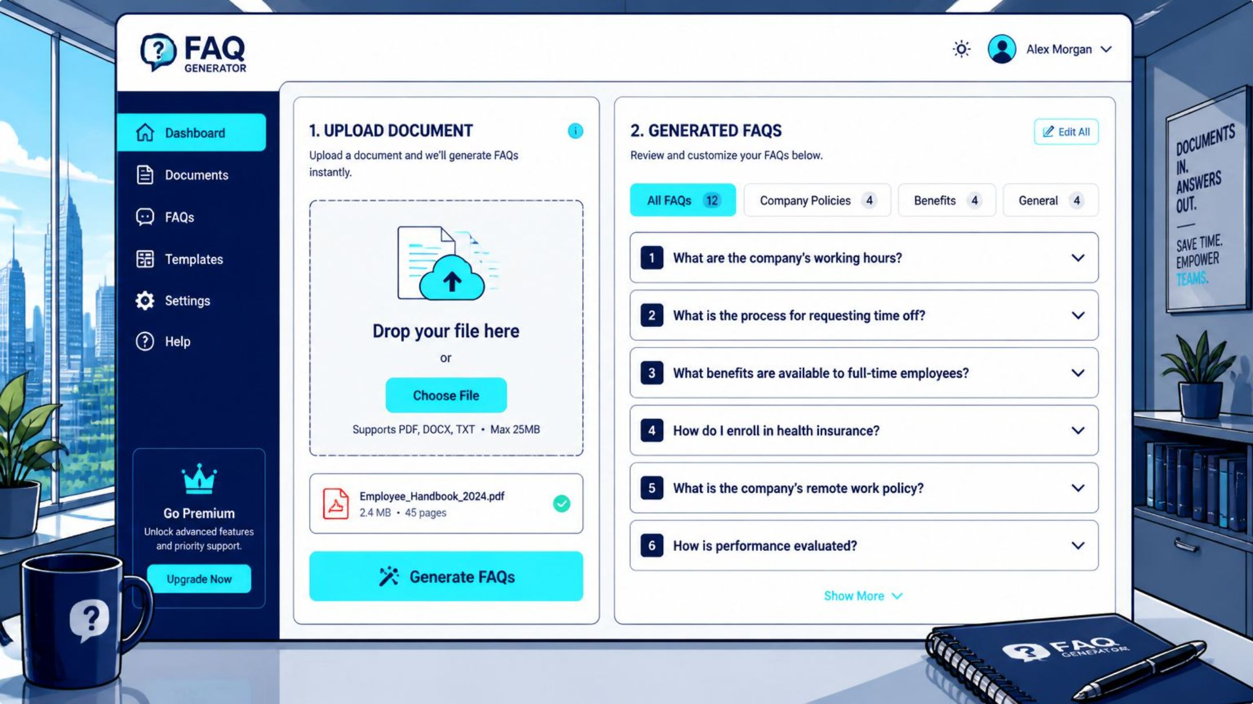
Expected Output & Applications
Sample User Flow
User uploads a PDF or text document.
The system processes the content automatically.
Generated FAQs are displayed in a searchable and exportable format.
FAQs can also be downloaded for future use.
Software Docs
Educational Materials
Product Manuals
Knowledge Management
Technical support
API Documentation

Slide 13
Methodology
The proposed system follows a sequential NLP-based methodology for automatically generating FAQs from technical documents.
1. Document Upload
Users upload technical documents in PDF, DOCX, or TXT format.
2. Text Extraction
The system extracts readable text from the uploaded document.
3. Text Preprocessing
Extracted text is cleaned by removing unnecessary spaces, symbols, and irrelevant content.
4. Sentence Segmentation
The processed text is divided into meaningful sentences.
5. Text Chunking
Large documents are divided into smaller manageable text chunks for efficient processing.
6. T5 Transformer Processing
The T5 Transformer analyzes the context and generates relevant question–answer pairs.
7. FAQ Post-Processing
Generated FAQs are organized, cleaned, and prepared for display.
8. FAQ Storage & Search
The generated FAQs are stored in a searchable knowledge base.
9. Web Application
Users can search, view, copy, provide feedback, and export the generated FAQs.
Methodology Flow:
Upload → Extract → Preprocess → Segment → Chunk → T5 Generation → Post-Process → Store → Search & Display

Slide 14
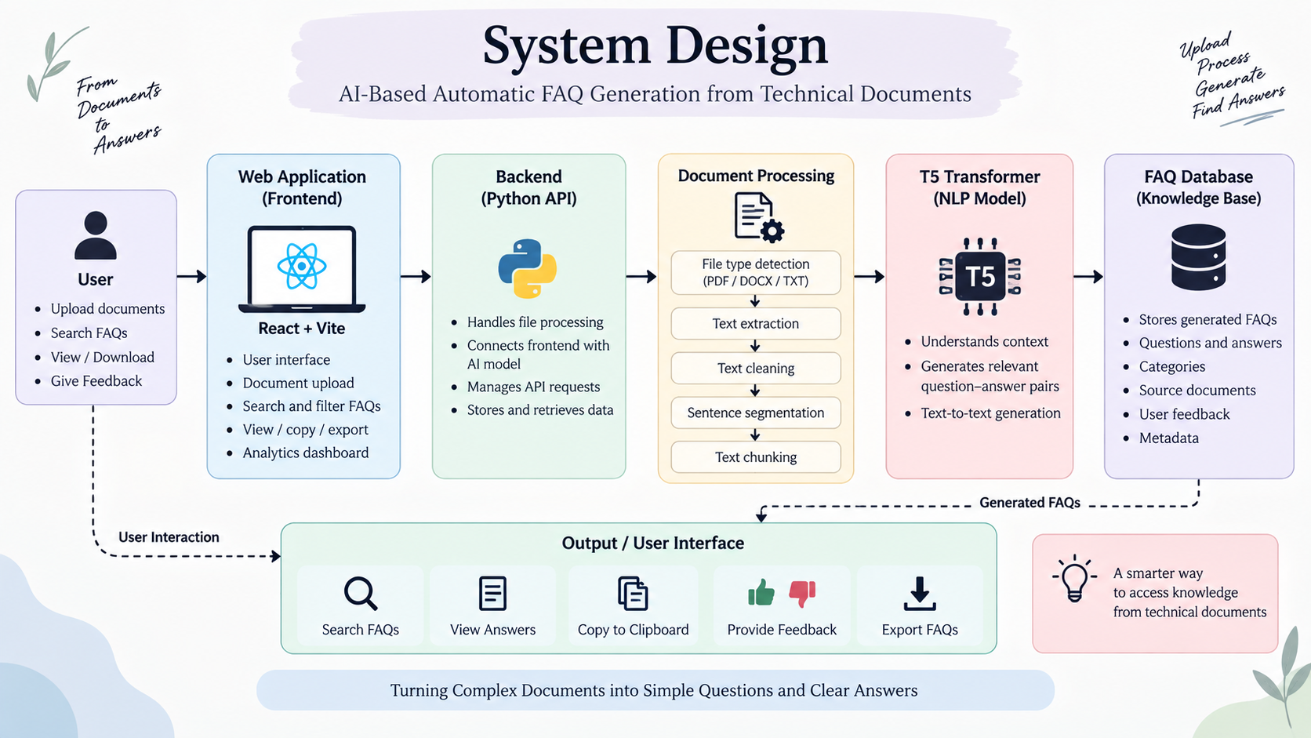
System Design
Input: PDF / DOCX / TXT
Processing: NLP + T5 Transformer
Output: Contextual Question–Answer pairs

Slide 15
Modern Tools & Technologies
AI / NLP:-
T5 Transformer
Natural Language Processing
Text preprocessing
Sentence segmentation
Text chunking
Frontend:-
React.js
Vite
HTML5
CSS3
JavaScript
Backend:-
Python
REST/API-based communication
Document processing modules
Data / Storage:-
FAQ knowledge base
Technical document datasets
PDF / DOCX / TXT input
Development Tools:-
Visual Studio Code
Git / GitHub
Jupyter / Python environment

Slide 16
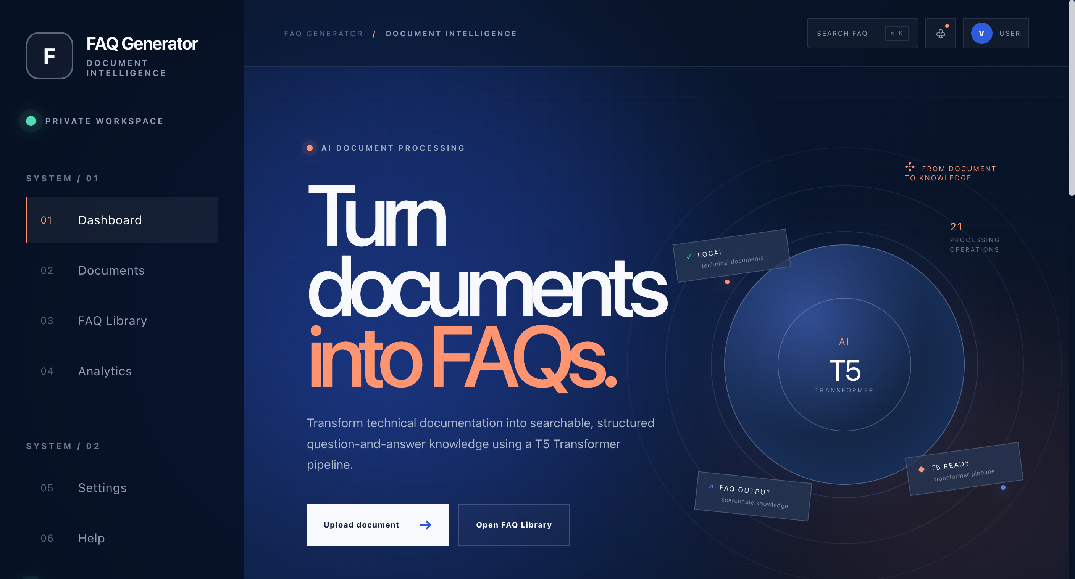
Implementation
Implemented Features
PDF, DOCX and TXT document upload
Automatic document processing workflow
FAQ generation interface
FAQ search and category filtering
Copy, feedback and export functionality
Analytics and notification support

Slide 17
Results
Input:-
Technical document
PDF / DOCX / TXT
Processing:-
Text extraction
Text preprocessing
Context analysis
FAQ generation
Output:-
Generated Questions
Generated Answers
Searchable FAQ Library
Copy / Export
User Feedback
Result: Technical documents are transformed into easily accessible question–answer information.

Slide 18
Performance Evaluation
Metric | What We Evaluate
Precision | Relevance of generated FAQs
Recall | Coverage of important information
F1-Score | Balance between precision and recall
BLEU | Similarity of generated questions with reference questions
ROUGE | Text overlap with reference answers
Response Time | Time required to generate FAQs
Human Evaluation | Correctness, relevance and readability
Evaluation Parameters:
Accuracy + Relevance + Readability + Response Time + User Feedback

Slide 19
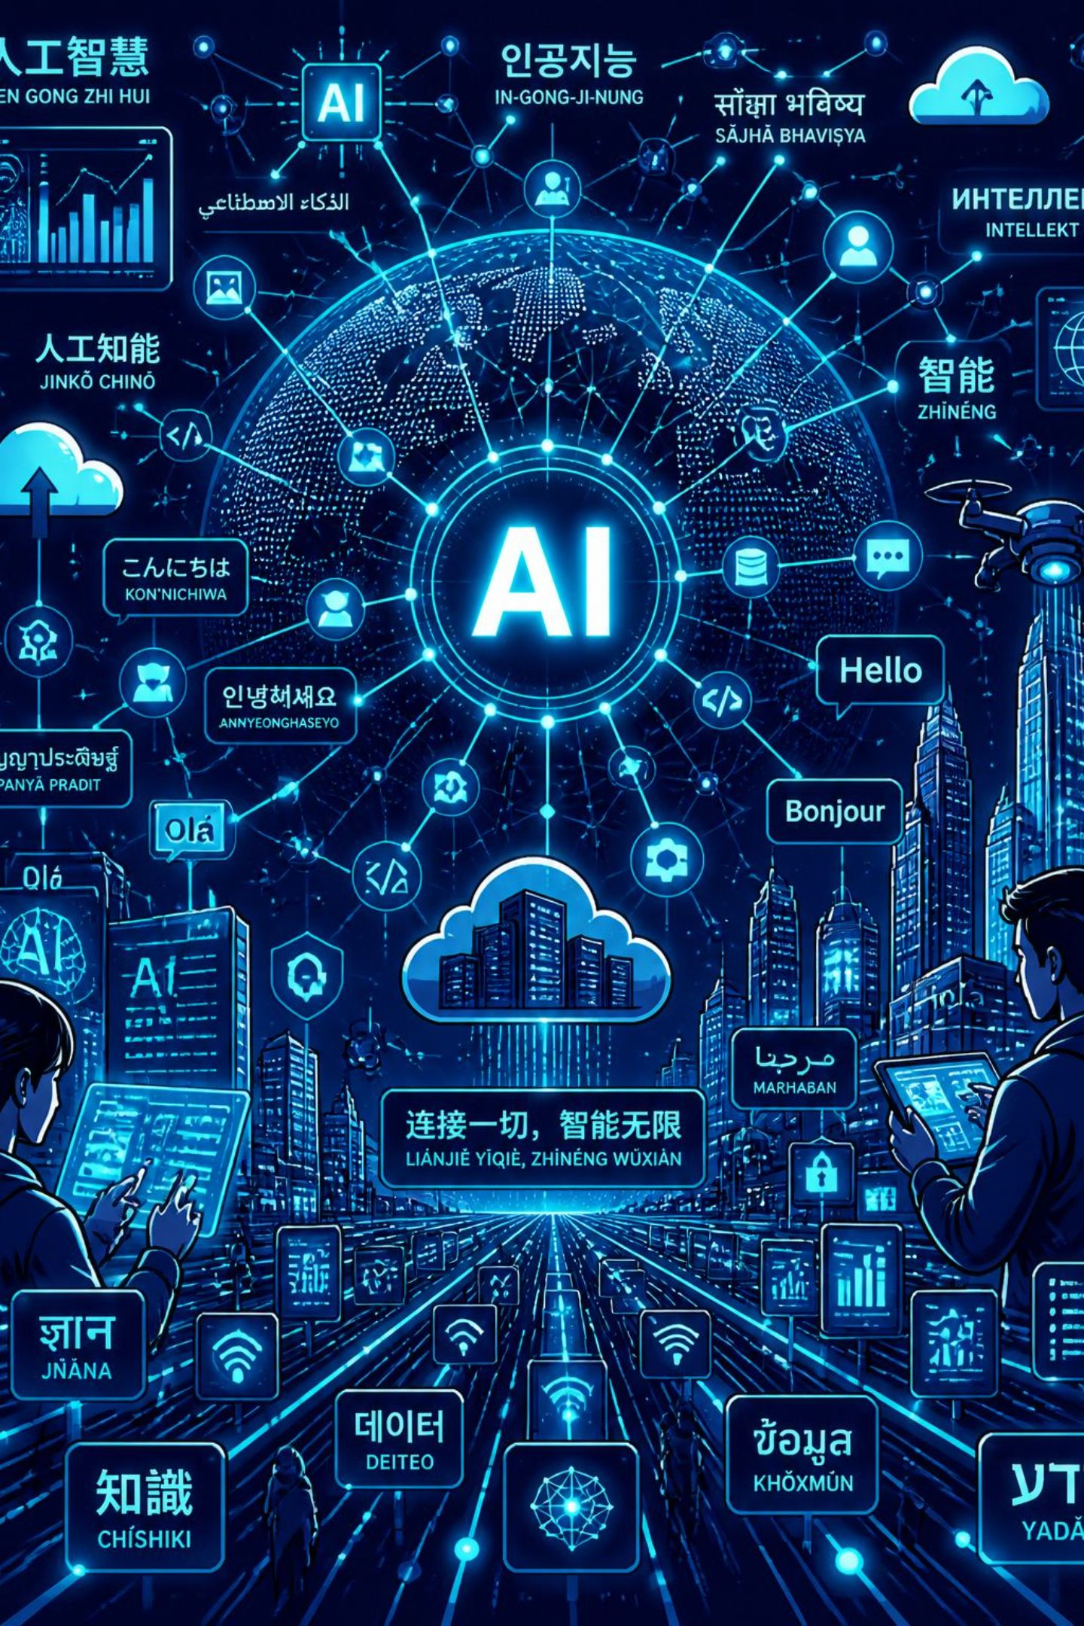




Future Scope
Multilingual Support
Extend FAQ generation to regional languages, and other global languages using multilingual T5 variants.
Chatbot Integration
Embed generated FAQs into an interactive chatbot for real-time user queries.
Voice-Based Search
Enable voice input and audio FAQ responses for accessibility and hands-free use.
Cloud & Mobile
Deploy on cloud infrastructure with a companion mobile app for on-the-go access.

